Slide 1
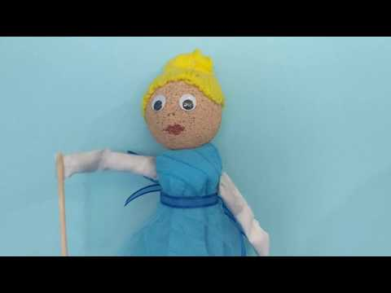
@sculleryprincess
Notes:
intro

Slide 2



Slide 3
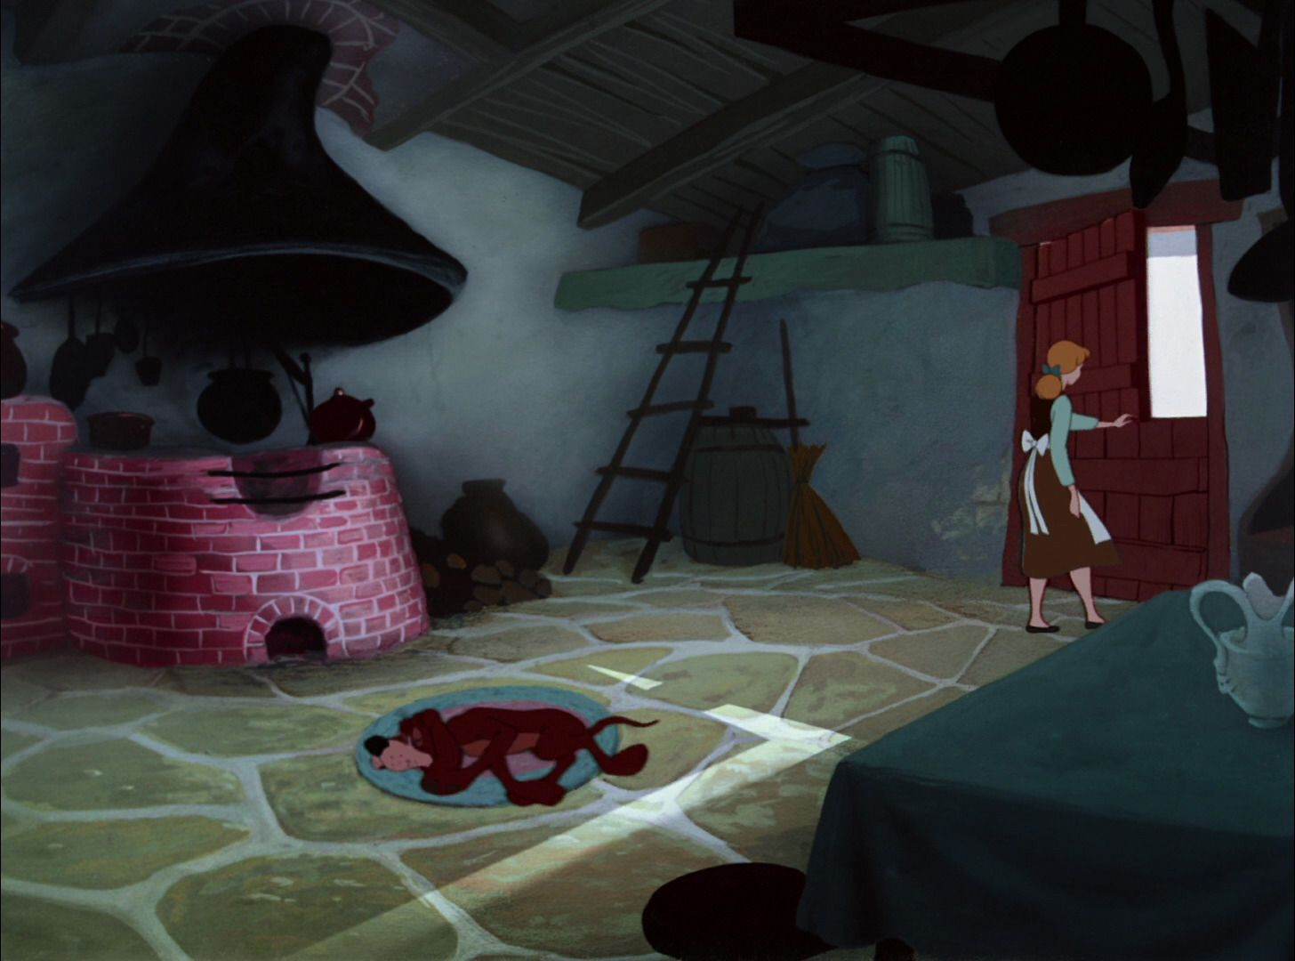


“Cinderella, clean up the kitchen!”
“Yes, mother.”

Slide 4
“Cinderella, clean up the fireplace and pick out each lentil!”
“Yes, mother.”

Slide 5
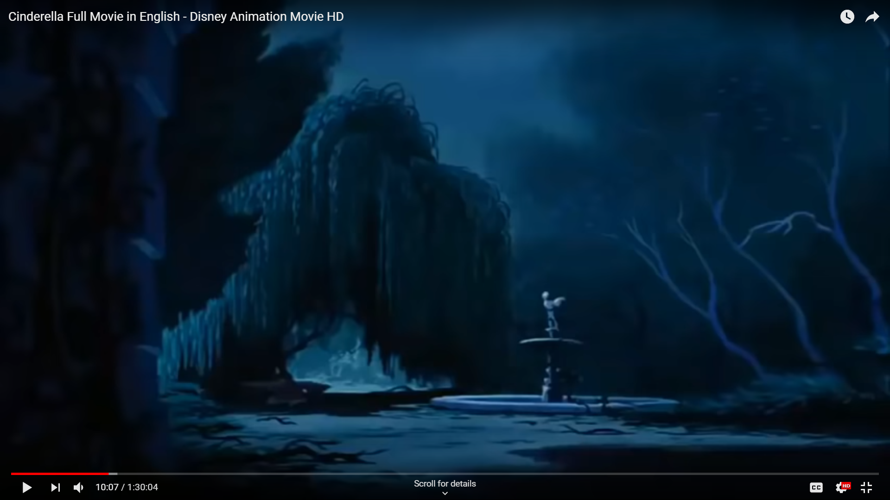
“Cinderella, you are lucky to live in my house when I could have banished you instead.”
“Yes, mother.”

Slide 6
“I am tired of how she treats me like her servant. One day, I will leave this place forever!”

Slide 7


“I am going to that ball. I heard the host is quite charming!”

Slide 8
“Screw the monarchy! I am done with those elitists, like my vile stepmother and sister.”

Slide 9
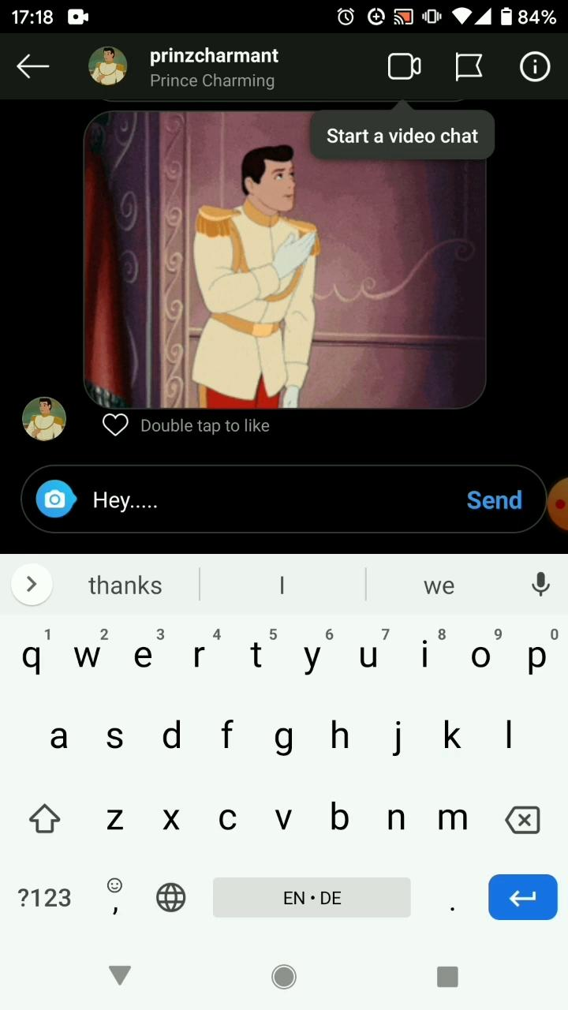

Slide 10
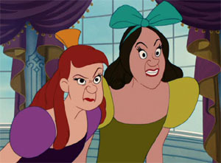
“The Prince & I banish you from our kingdom. Away with you, wicked sisters!

Slide 11
“Attack them, o bird friends! Peck out their eyeballs!”

Slide 12
the end

Slide 13
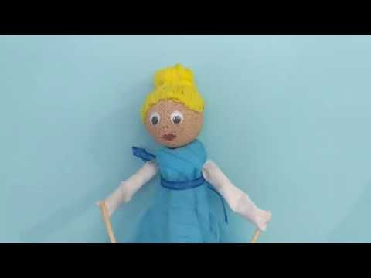
Notes:
outro

